Slide 1

Multiclass, Multicriteria Traffic Assignment Problem and Its Applications
Anthony Chen
Professor of Civil and Transportation Engineering
Department of Civil & Environmental Engineering
Hong Kong Polytechnic University
Email: anthony.chen@polyu.edu.hk

Slide 2
Objectives
Strengthen students’ knowledge on modeling by using fundamentals
Understand the fundamentals (not only how but also why), particularly on the original development on new models, solution algorithms, and applications
Capable of using fundamentals for your own research

Slide 3
Outline
Review of elastic demand traffic assignment problem
Multiclass traffic assignment problem
Models focusing on different travelers’ characteristics
Models focusing on different vehicle types
Multicriteria traffic assignment problem
Models focusing on deterministic attributes
Models focusing on stochastic attributes
Multiclass, multicriteria traffic assignment problem

Slide 4
Review of Elastic Demand Traffic Assignment Problem

Slide 5
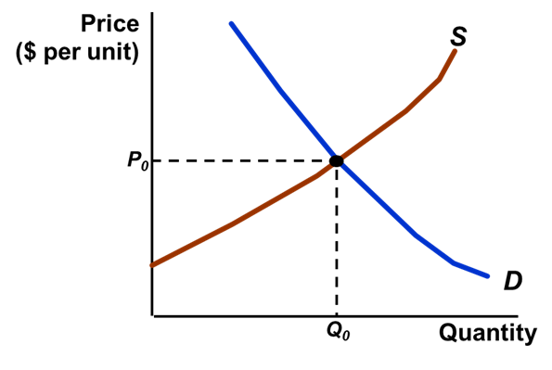
Demand-Supply Relationship at Various Spatial Levels
Demand function
Separable
Non-separable
Volume (or Flow)
Cost (or LOS)
Interzonal
Demand allocation
DUE
SUE
Other
Assignment principle
Deterministic
Stochastic
Other
Path/Route
Path cost structure
Additive
Non-additive
Path-link incidence
Link
Link cost function
Separable
Non-separable

Slide 6
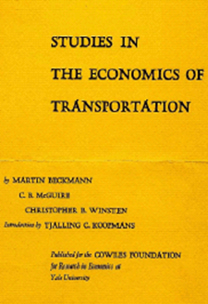
Deterministic User Equilibrium: Mathematical Programming (MP) Formulation for Elastic Demand
User Equilibrium Objective
for Elastic Travel Demand
Subject to:
Travel Demand
Conservation Constraints
Defintional Constraints
Non-negativity Constraints
Q: What are the main differences compared to the fixed demand formulation?

Slide 7
Interpretation
For a given O-D pair, if
and
Uniqueness
Since
is monotonically decreasing and
is strictly increasing, Z(v,q) has a unique solution in terms
of O-D demands and link flows.

Slide 8
Benefits of Mathematical Programming (MP) Formulation
The optimality conditions directly provide the equivalency between the MP formulation and the choice probability (i.e., similar to the Beckmann transformation used as the objective function for the user equilibrium MP formulation and its relationship to the Kuhn-Tucker conditions, which are readily interpretable and easily understandable)
Convergent algorithms are readily available given the MP formulation (i.e., complete linearization algorithm (also known as the Frank-Wolfe algorithm or the convex combinations method) for solving the UE problem and partial linearization algorithm (or Evans’ algorithm) for solving the SUE problem as well as many combined models
Objective function provides not only a suitable search direction and a suitable step size in a typical solution algorithm, but also as a stopping criterion to monitor the convergence

Slide 9
Different Choice Dimensions of Elastic Demand
The standard UE network assignment problem can be viewed as a model of motorists’ choice of path from origin to destination regardless of congestion level (fixed demand).
One would expect not just assignment but also distribution, mode, and generation to respond to congestion.
The variable-demand equilibrium assignment problem can be viewed as a model to describe the choice of not to travel, in addition to path choices (i.e., trip generation).
The joint mode split/equilibrium assignment problem can be viewed as a model to describe the choice of an alternative travel mode (i.e., mode choice).
The joint distribution/assignment problem determines motorists’ choice of destination and the path used to get there (i.e., trip distribution).

Slide 10
Solution by Representation
Basic Network
Zero-Cost Overflow Link
Elastic Demand Link
Zero-Cost Overflow
Network Representation

Slide 11
Zero-Cost Overflow Formulation
Elastic Demand Link
Zero-Cost Overflow Link
Subject to:
Demand on the
Basic Network
Excess Demand
on the Overflow Link

Slide 12
Excess Demand
New variable
of integration

Slide 13
Excess Demand Formulation
Subject to:
Excess Demand Function

Slide 14
Excess Demand Formulation: Combined Modal Split/Traffic Assignment Problem
A network equilibrium problem in which the network includes both
automobile and transit (e.g., metro) modes.
Logit Mode Split Function
Inverse Demand Function
Excess Demand Function

Slide 15
Combined Modal Split/Traffic Assignment Formulation
Subject to:
Excess Demand Function
Transit Demand
Vehicular Demand
At Equilibrium
Logit Modal Split for Transit

Slide 16
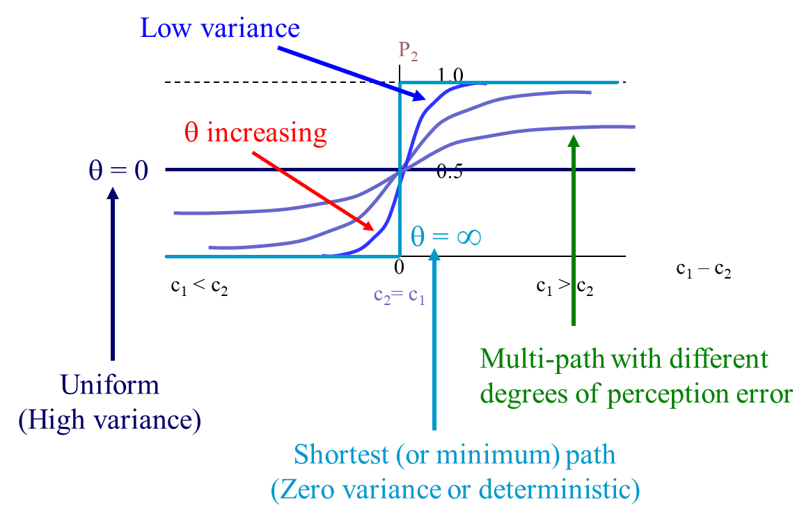
Excess Demand Formulation: A Special Case for Fixed Demand Stochastic User Equilibrium Problem
Entropy term to capture the variability of user response
Related to the scale parameter
subject to
Travel Demand
Conservation Constraints
Definitional Constraints
Non-negativity Constraints
KKT Conditions give
Fisk, C., 1980. Some developments in equilibrium traffic assignment. Transportation Research Part B 14(3), 243-255.

Slide 17
Recent Advanced Closed-form Discrete Choice Models
Mode choice analysis
U.S. Department of Transportation
Federal Transit Administration
(Koppelman and Bhat, 2006)
Route choice analysis
(Bekhor and Prashker, 1999)
Location choice analysis
(Bhat and Guo, 2004)
Koppelman, F. S., & Bhat, C. (2006). A self instructing course in mode choice modeling: multinomial and nested logit models. Prepared for US Department of Transportation Federal Transit Administration.
Bhat, C. R., & Guo, J. (2004). A mixed spatially correlated logit model: formulation and application to residential choice modeling. Transportation Research Part B: Methodological, 38(2), 147-168.
Bekhor, S., & Prashker, J. N. (1999). Formulations of extended logit stochastic user equilibrium assignments. In 14th International Symposium on Transportation and Traffic Theory.

Slide 18
Closed-Form Route Choice and SUE Models with Gumbel and Weibull Variates
Kitthamkesorn, S., Chen, A. (2014) An unconstrained weibit stochastic user equilibrium model with extensions. Transportation Research Part B 59, 1-21

Slide 19
Research Opportunities
Relax the fixed demand of the traffic equilibrium model to consider variable demand based on the level-of-service (LOS) similar to demand and supply analysis.
Extend/Adapt the basic traffic equilibrium model to consider additional issues (e.g., travel choice, mode choice).
Modify the convex combinations method to determine variable demand.
Research: relax various traffic equilibrium models to consider elastic demand (e.g., C-logit-ED, PCL-ED, CNL-ED, PSW-ED, etc.); modify traffic assignment algorithms to consider elastic demand/mode choice (e.g., path-based partial linearization method; modified gradient projection method, etc.); apply the new models/algorithms for different applications (e.g., go-green modes, active modes, etc.)

Slide 20
Elastic Demand SUE Models with Gumbel and Weibull Variates

Slide 21

Model Development
Extension

Slide 22
Chapter 7: Trip Distribution and Traffic Assignment Models
The UE Distribution/Assignment Problem
Mathematical Programming (MP) Formulation
Solution by Network Representation
Distribution/Assignment with Destination Demand Functions
Distribution/Assignment with Variable Destination Cost
Doubly Constrained Models
Concluding Remarks
CDA Models and Applications
New Opportunities

Slide 23
Combined Distribution-Assignment Formulation
Subject to:
Destination
Attractiveness
(e.g., retail activity,
employment density, etc.)
Lagrange
Multiplier
the smallest net travel impedance, ,
of all destinations that can be visited from r

Slide 24
Observations
Each destination is assumed to be associated with some attraction measure reflecting the activity opportunities available there.
Travel to the destination with the highest attraction measure while spending the least possible time in travel.
Choice of destination is the result of a trade-off between attraction and travel time.
Applications: shopping malls, parking, evacuation, etc.

Slide 25
Combined Distribution-Assignment Formulation with Destination Demand Function
In the variable-demand user-equilibrium problem, a demand function is used to determine the number of trips.
In the problem of distribution/assignment with destination demand functions, the “trip production” constraint
If both conditions are both imposed at equilibrium, then the system of equations may not have a solution since the number of equations exceeds the number of variables.

Slide 26
Example
Link Cost Functions
Demand Functions
Optimal Solution
But does not satisfy
Trip Production Constraint

Slide 27
Example
Resolve the above problem by using the demand functions to satisfy
the trip production constraint
Demand function is specified by a share model
Multinomial Logit
where

Slide 28
Combined Distribution-Assignment Formulation with Destination Demand Function
Subject to:
Entropy
Destination
Attractiveness
(e.g., retail activity,
employment density, etc.)
Lagrange
Multiplier
the smallest net travel impedance, ,
of all destinations that can be visited from r

Slide 29
Combined Distribution-Assignment Formulation with Variable Destination Cost
Subject to:
Entropy
Destination Cost
(e.g., retail activity,
employment density, etc.)
Lagrange
Multiplier
the smallest net travel impedance, ,
of all destinations that can be visited from r

Slide 30
Joint Entropy Distribution-Assignment Formulation (Doubly-Constrained Gravity Model)
Subject to:
Lagrange
Multiplier

Slide 31
Integrated O-D, Mode, and Route Choice Model (Boyce and Bar-Gera, 2003)
O-D Choice
Mode Choice
User-optimal
Route Choice
Integrated Model of O-D,
Mode and Route Choice

Slide 32
Combined
Strategic Urban Transport
Combined Multiclass
Model
Study
–
ESTRAUS
Multimodal Choice Model
•
authors
de Cea & Fernandez (2003)
Boyce & Bar
-
Gera (2003)
•
region
Santiago, Chile
Chicago, USA
•
base year
1986
1990
•
forecasts
1995 & 2010
no foreca
sts prepared
Classes
13 classes; 3 trip purposes
home
-
work; home
-
other; truck
Modes
11 combinations of modes
auto; transit
Networks
road with auto, taxi and bus;
separate networks for road and
transit with metro and
transit
exclusive bus lanes
Formula
tion
variational inequality
constrained optimization
•
O
-
D
DC negative exponential fn.
DC negative exponential fn.
•
mode
nested logit function
nested logit function
•
period
three departure time periods
none
•
route
auto
-
UO; transit
-
UO; walk
auto
-
UO; trucks
-
UO
•
zones
450
1,790
•
nodes
2,500
12,982
•
road links
8,000
39,018

Slide 33
CDA Models (Review Before 2015)
Yao, J., Chen, A., Ryu, S., Shi, F. (2014) A general unconstrained optimization formulation for the combined distribution and assignment problem. Transportation Research Part B 59, 137-160.

Slide 34
CDA Applications (Review Before 2015)
Network capacity models (Yang et al., 2000; Kasikitwiwat and Chen, 2005)
Capacity reliability and flexibility analyses (Chen and Kasikitwiwat, 2011; Chen et al., 2013)
Network vulnerability assessment analysis (Chen et al., 2007)
Network design problems (Boyce and Janson, 1980)
Car ownership problems (Tam and Lam, 2000, 2004; Feng et al., 2010)
Network design and land use problems (Los and Nguyen, 1981; Shen, 1997; Lin and Feng, 2003; Lee et al., 2006; Yim et al., 2011)
Taxi operation modeling (Yang et al., 2002; Wong et al., 2001, 2008)
Yao, J., Chen, A., Ryu, S., Shi, F. (2014) A general unconstrained optimization formulation for the combined distribution and assignment problem. Transportation Research Part B 59, 137-160.

Slide 35
New CDA Opportunities in Model Developments and Applications
Recent advances in discrete choice/random utility theories
New models developed for spatial analysis (e.g., spatially correlated logit model by Bhat and Guo (2004), Bekhor and Prashker (2008), etc.)
Opportunities to collaborate with geographers specializing in spatial analysis
New random utility models (e.g., weibit model; q-generalized logit model; representative agent model, such as marginal distribution model (MDM) and cross moment model (CMM); semi-parametric models; distributionally robust model; bounded choice model; combination of random utility models (CoRUM), copula model, etc.)
Emerging technology applications
Electric vehicles (e.g., CDA model with consideration of charging stations)
Ridesharing system (e.g., matching passengers and drivers)
Connected vehicles (i.e., mixed traffic with human-driven vehicles)
Smart mobility in the context of smart city

Slide 36
Multiclass Traffic Assignment Problem
Dafermos, S.C., 1972. The traffic assignment problem for multiclass-user transportation networks. Transportation Science 6(1), 73-87
Daganzo, C.F., 1983. Stochastic network equilibrium with multiple vehicle types and asymmetric, indefinite link cost Jacobians. Transportation Science 17(3), 282-300

Slide 37
Multiclass Traffic Assignment Problem
Models focusing on different travelers’ characteristics
Users with different valuations of travel times (Nagurney, 2000; Nagurney and Dong, 2002; Yang and Huang, 2004; Huang and Li, 2007)
Users with different risk-taking behaviors (Lo et al., 2006; Shao et al., 2006; Di et al., 2008; Xu et al., 2014)
Users with different knowledge levels of network travel times (Yang, 1998; Huang and Li, 2007; Miwa et al., 2010; Chen et al., 2012)
Models focusing on different vehicle types
Trucks and passenger cars (Daganzo, 1983; Toint and Wynter, 1996; Mahmassani and Mouskos, 1998; Wu et al., 2006; Noriega and Florian, 2007; Ryu et al., 2016)
Buses and passenger cars (García and Marín, 2005; De Cea et al. 2005; Sun et al., 2008)
Bicycles and passenger cars (Si et al., 2012; Subhani et al. 2013)
Autonomous vehicles and human-driven vehicles (many recent articles on this topic)

Slide 38
Modeling Issues
Network uncertainty
User behaviors
Trip lengths
Knowledge levels of network travel times
Valuations of travel times (discrete versus continuous VoT)
Risk-taking behaviors (related to network uncertainty)
Vehicle interactions
Equivalent passenger car unit (PCU)
Asymmetric interactions
Different driving behaviors (e.g., autonomous vehicles and human-driven vehicles)

Slide 39
Uncertainty in Transportation Networks
39
Source: van Lint, J.W.C., van Zuylen, H.J., Tu, H. (2008) Travel time unreliability on freeways: Why measures based on variance toll only half the story. Transportation Research Part A 43(2), 258-277.
Notes:
39

Slide 40
Travel Time Distribution: Examples
Source: Cambridge Systematics, Inc., Texas Transportation Institute, University of Washington, Dowling Associates (2003) Providing a highway system with reliable travel times. NCHRP Report No. 20-58[3], TRB, National Research Council, U.S.A.
40

Slide 41
Empirical Studies on Travel Time Reliability
1996 Study by UC Davis
54% respondents indicated that travel time reliability was either the primary or secondary reason for choosing their daily commute routes
SR-91 Study by UC Irvine
Value of reliability is 39% to 46% higher than the value of time
Small et al. (1999)
Travelers are willing to pay for more reliable trip, from $0.17 – $0.26/per min of standard deviation
USDOT FHWA (2001)
Shippers and carriers assign a value, ranging from $25 to almost $200 per hour, depending on the product carried
41

Slide 42
Empirical Studies on Travel Time Unreliability
van Lint et al. (2007)
About 5% of the “unlucky drivers” incur almost five times as much delay as the 50% of the “fortunate drivers” on the densely used freeway corridors in the Netherlands
USDOT FHWA (2001)
The cost of unexpected delay for trucks is another 50 percent to 250 percent higher than expected delay
Franklin and Karlstrom (2009)
Estimate the “mean lateness factor” for cost-benefit analysis of Stockholm roadways
42
Notes:
Some empirical studies have revealed that travel time variability plays an important role in travelers’ route choice decision processes (Abdel-Aty et al., 1995; Brownstone et al., 2003; Liu et al., 2004; de Palma and Picard, 2005; Fosgerau and Karlström, 2010).
Travelers treat the travel time variability as a risk in their travel choices, because it introduces uncertainty for an on-time arrival at the destination.

Slide 43
Network Equilibrium Models under Uncertainty
where:
DN = Deterministic Network
SN = Stochastic Network
DUE = Deterministic User Equilibrium
SUE = Stochastic User Equilibrium
Chen, A., Ji, Z., Recker, W. (2002) Travel time reliability with risk sensitive travelers. Transportation Research Record 1783, 27-33.

Slide 44
Mean-Excess Travel Time (METT)
how long do I need to allow for this trip?
how bad should I expect for the worse cases?
TTB
Expected Excess Delay
Chen, A. and Zhou, Z. (2009) The a-reliable mean-excess traffic equilibrium model with stochastic travel times. Transportation Research Part B 44(4), 493-513.
Notes:
44

Slide 45
User Behavior: Knowledge or Trip Length
Single dispersion parameter (Fisk, C., 1980. Some developments in equilibrium traffic assignment. Transportation Research Part B 14(3), 243-255)
Structured dispersion parameter (Miwa, T., Okada, Y., Morikawa, T., 2010. Applying a structured dispersion parameter to multiclass stochastic user equilibrium assignment model. Transportation Research Record 2196, 142-149)
Scaled dispersion parameter (Chen, A., Pravinvongvuth, S., Xu, X., Ryu, S., Chootinan, P., 2012. Examining the scaling effect and overlapping problem in logit-based stochastic user equilibrium models. Transportation Research Part A 46(8), 1343-1358)
Weibit SUE with shape parameter (Kitthamkesorn, S., Chen, A., 2013. A path-size weibit stochastic user equilibrium model. Transportation Research Part B 57, 378-397)
Two dispersion parameters to represent equipped and non-equipped drivers (Yang, H., 1998. Multiple equilibrium behavior and advanced traveler information systems with endogenous market penetration. Transportation Research Part B 32(3), 205-218)
Etc.

Slide 46
Scaling the Dispersion Parameter
CV = 0.5
i
j
i
j
(θ=0.51)
(θ=0.02)
PDF
Same perception variance
Same perception variance
5
10
120
125
Perceived travel cost
Chen, A., Pravinvongvuth, S., Xu, X., Ryu, S. and Chootinan, P., 2012. Examining the scaling effect and overlapping problem in logit-based stochastic user equilibrium models. Transportation Research Part A, 46(8), 1343-1358.

Slide 47
Weibit-based SUE Mathematical Programming Formulation (Kitthamkesorn and Chen, 2013)
Weibit-based SUE Objective
for Fixed Travel Demand
Shape Parameter
subject to
Travel Demand
Conservation Constraints
Definitional Constraints
Non-negativity Constraints
Kitthamkesorn, S., Chen, A. (2013) A path-size weibit stochastic user equilibrium model. Transportation Research Part B 57, 378-397.

Slide 48
Heterogeneous (or Route-Specific) Perception Variance
Assume
i
j
i
j
MNW model
CV = 0.5
Relative cost difference
PDF
Route-specific perception variance
5
10
120
125
Perceived travel cost

Slide 49
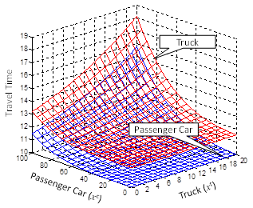
Link Performance Function

Slide 50
Extensions
Multimodal transportation networks
Different physical and/or virtual networks
Supernetwork Concept
See Nagurney’s Virtual Center for Supernetworks
Applications: decision-making, optimization, and game theory; supply chain management; critical infrastructure from transportation to electric power networks; financial networks; knowledge and social networks; energy, the environment, and sustainability; cybersecurity; Future Internet Architectures; risk management; network vulnerability, resiliency, and performance metrics; humanitarian logistics and healthcare
https://supernet.isenberg.umass.edu/

Slide 51
Considering Late Arrival in Multi-Class Risk-Averse Traffic Assignment Model
Xu, X., Chen, A., Zhou, Z., Cheng, L., 2014. A multi-class mean-excess traffic equilibrium model with elastic demand. Journal of Advanced Transportation 48(3), 203-222.

Slide 52
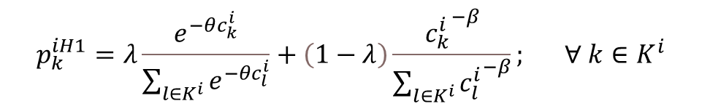
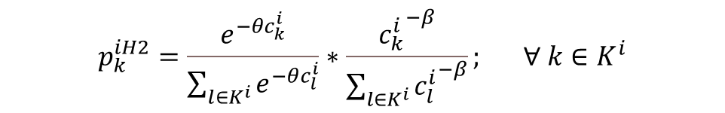
What is the meaning of a multiclass traffic assignment problem with two probability choice models?
Hybrid/Latent Class (Model 1: Additive Form)
Hybrid/Latent Class (Model 2: Multiplicative Form)
Yao, J., Chen, A. (2014) An analysis of logit and weibit route choices in stochastic assignment paradox. Transportation Research Part B 69, 31-49.
Xu, X., Chen, A., Kitthamkesorn, S., Yang, H., Lo, H.K. (2015) Modeling absolute and relative cost differences in stochastic user equilibrium problem. Transportation Research Part B 81, Part 3, 686-703.

Slide 53
Recall the Travel Impedance Functions
Travel
impedance
Power function:
Exponential function:
Combined (Gamma) function:
Travel cost
53

Slide 54
Some Preliminary Questions?
What can we learn from different impedance functions of the trip distribution step?
What is the difference between the additive and multiplicative model?
54

Slide 55
Multicriteria Traffic Assignment Problem

Slide 56
Multicriteria Traffic Assignment Problem
Also known as multi-objective traffic assignment problem
Weighted sum approach
Weights can be flow-independent or flow-dependent
Additive or non-additive
Pareto (or non-dominated) solutions

Slide 57
Pareto/nondominated/efficient solution
Definition: A solution is called Pareto optimal, if none of the objective functions can be improved without degrading some of the other objective values.
An example:
Suppose that for a bi-objective optimization problem, the feasible domain only includes solution 1, solution 2, and solution 3.
Obj. 2
Dominated area by solution 1
Pareto solutions:
Solution 1 and solution 2
Dominated solution:
Solution 3
Solution 1
Solution 3
Dominated area by solution 2
Solution 2
Obj. 1

Slide 58

Approaches for multi-objective
Weighted sum method
$ε$-constraint method

Slide 59
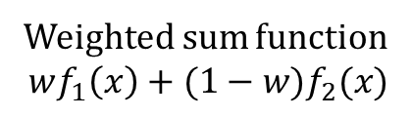
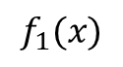
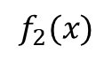
Weighted sum approach
Scale the objective functions
Weighted sum function
$$wf_{1}\left(x\right)+(1−w)f_{2}(x)$$
$$f_{1}(x)$$
Pareto solution
Value of obj. 2
Feasible domain
$$f_{2}(x)$$
Value of obj. 1
Problem: scaling problem.

Slide 60
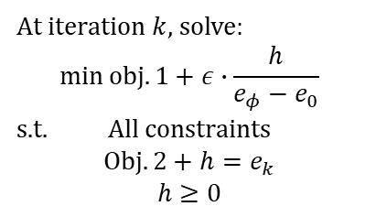
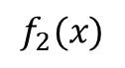

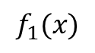
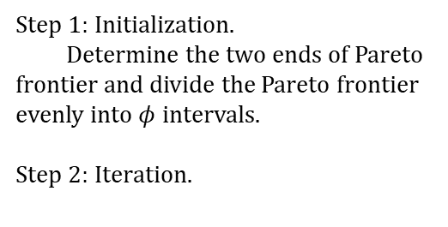
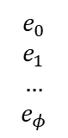
$ε$-constraint approach
Pareto frontier
Step 1: Initialization.
Determine the two ends of Pareto frontier and divide the Pareto frontier evenly into $φ$ intervals.
Step 2: Iteration.
Generated solution
$$f_{1}(x)$$
Obj. 2
Feasible region
$$e_{0}$$
$$e_{1}$$
$$…$$
$$e_{φ}$$
At iteration $k$, solve:
$$\min{obj.1}+ε∙\frac{h}{e_{φ}−e_{0}}$$
s.t. All constraints
$$Obj.2+h=e_{k}$$
$$h≥0$$
$$f_{2}(x)$$
Search direction
Obj. 1

Slide 61
Bi-Objective User Equilibrium Model under Network Uncertainty
Wang, J.Y.T, Ehrgott, M., Chen, A. (2014) A bi-objective user equilibrium model of travel time reliability in a road network. Transportation Research Part B 66, 4-15.

Slide 62
Bi-Objective User Equilibrium Model under Network Uncertainty: Results
Wang, J.Y.T, Ehrgott, M., Chen, A. (2014) A bi-objective user equilibrium model of travel time reliability in a road network. Transportation Research Part B 66, 4-15.

Slide 63
Multiclass, Multicriteria Traffic Equilibrium Problem

Slide 64
Papers
Nagurney, A., 2000. A multiclass, multicriteria network equilibrium model. Mathematical and Computer Modeling 32(3-4), 393-411
Nagurney, A., Dong, J., 2002. A multiclass, multicriteria traffic network equilibrium model with elastic demand. Transportation Research Part B 36(5), 445-469
Yang, H., Huang, H.J., 2004. The multiclass, multicriteria traffic network equilibrium and system optimum problem. Transportation Research Part B 38(1), 1-15
Huang, H.J., Li, Z.C., 2007. A multiclass, multicriteria logit-based traffic equilibrium assignment model under ATIS. European Journal of Operational Research 176(3), 1464-1477
Notes:
64

Slide 65

Questions & Answers
Website: https://www.polyu.edu.hk/cee/people/anthony.chen/

